Slide 1
Introduction to Maven
Rajeev Gupta MTech CS
Trainer & Consultant

Slide 2
Course Goals / Objectives
Overview of Maven3
The Maven repositories
Maven Archetypes
Maven 3 life cycle phases
How to set the environment for Maven 3
The pom.xml file
How to customize the pom.xml file
How to create Eclipse related files using Maven
How to create a WAR file

Slide 3
What is maven?
Build tool
A software project management and comprehension tool.
It can manage the build of project, documentation and reporting from a central piece of information
Maven is hosted by Apache Software Foundation
Maven uses POM (Project Object Model) in order to describe the software project which is being built, it’s dependencies on other external modules and build order.
Maven comes with predefined targets for performing certain tasks like compilation of code and it’s packaging.
Maven is network-ready. The core engine can dynamically download plug-ins from a repository.
What is Maven ?
Notes:
Faculty Notes:
You can download Maven 2 from http://maven.apache.org/download.html.
1

Slide 4
Setting the environment for Maven 3
Download maven from
http://maven.apache.org/download.cgi
Unzip the installation archive to c:/
Set the M2_HOME and Path environment variables in the following way:
set M2_HOME
C:\tools\maven3.1
PATH
%M2_HOME%\bin
Notes:
Solutions Engineering Fundamentals: Java
Course #Z16325
© 2009 Accenture All Rights Reserved.
1

Slide 5

Setting the environment for Maven 3
If installed correctly, you should be able to test it by opening a command prompt and typing :
The output should be like this:

Slide 6
Maven Key terms
Archetype - is a template of a project which is combined with some user input to produce a working Maven project that has been tailored to the user's requirements
POM - The pom.xml file is the core of a project's configuration in Maven. It is a single configuration file that contains the majority of information required to build a project.
Dependencies - Maven allows projects to declare what dependencies they have, and will automatically materialize those dependencies
Notes:
http://maven.apache.org/guides/getting-started/index.html
1

Slide 7
Maven Repositories
Maven repositories store a set of artifacts which are used by Maven during dependency resolution for a project.
Local repositories can be accessed on the local hard disk.
Remote repositories can be accessed through the network.
An artifact is bundled as a JAR file which contains the binary library or executable.
An artifact can also be a war or an ear.
Notes:
Solutions Engineering Fundamentals: Java
Course #Z16325
© 2009 Accenture All Rights Reserved.
Faculty Notes:
Resolving Project Dependencies
During the build process, the project dependencies are resolved with the help of Maven 3 dependency management engine. Dependencies are specified in <dependencies> elements within a pom.xml file. Project dependencies are stored on repository servers. The dependencies resolver attempts to resolve the dependencies in the following order:
Your local repository is checked for the dependency.
A list of remote repositories is checked for the dependency.
In case, 1 and 2 fail, an error is reported.
By default, the first remote repository contacted in step 2 is a worldwide-accessible centralized Maven 2 repository containing artifacts for most popular open source projects.
Local Repository
Your Maven 3 local repository is a directory on your disk, located at HomeDirectory/.m2/repository. This repository acts as a high-performance local cache, storing any artifacts downloaded as a result of dependency resolution.
Remote Repository
Remote repositories are accessed over the network. You can maintain a list of remote repositories to use in your settings.xml configuration file. The settings.xml file is present in the conf folder of apache-maven-3.x.x.

Slide 8
Maven 3 Archetypes
An archetype is a complete project template
Using an archetype, a project template can be created with a simple command
Following is a list of archetypes and their purposes.
Notes:
Maven provides command line utilities using which we can create project template, similar to the project creation options in Eclipse
Solutions Engineering Fundamentals: Java
Course #Z16325
© 2009 Accenture All Rights Reserved.
1

Slide 9
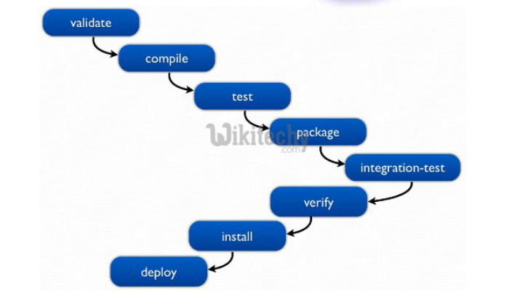
Maven 3 Life cycle phases
Compiles the source code and the classes are placed in the target directory tree
compile
test-compile
Compiles the source code of the unit tests.
test
Runs the compiled unit tests and verifies the results
Bundles the executable binaries into a distribution archive such as jar or war
package
install
Adds the archive to the local Maven directory. Thus making it available for any other module dependent on it.
Adds the archive to the remote Maven directory. Thus making the artifact available to a larger audience.
deploy

Slide 10
First Maven 3 project
Issue the following command from the directory that you want to contain SampleProject:
The above command provides the archetype plug-in with the coordinates of your module.
The command also creates a starter pom.xml file for the project along with the conventional Maven 2 directory structure.

Slide 11
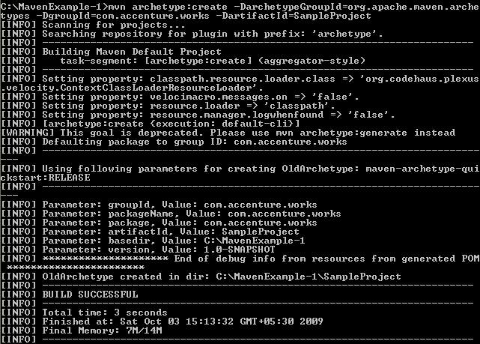
First Maven 3 project (Continued…)
The output should be similar to the following:
Notes:
Sumaiya – This is fine
Solutions Engineering Fundamentals: Java
Course #Z16325
© 2009 Accenture All Rights Reserved.
1

Slide 12
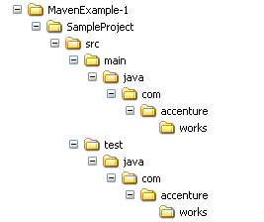
First Maven 3 project (Continued…)
The Archetype plug-in creates a directory tree, a pom.xml file and a placeholder App.java application.
It also creates a directory tree for unit test source code and a placeholder AppTest.java unit test.
The following figures shows the directory structure created:
Notes:
This is fine. Reference the steps
Solutions Engineering Fundamentals: Java
Course #Z16325
© 2009 Accenture All Rights Reserved.
1

Slide 13
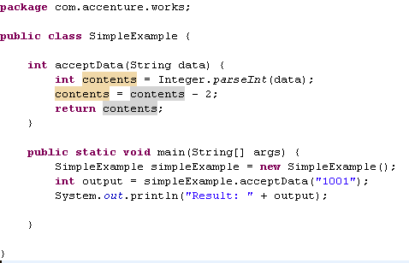
First Maven 3 project (Continued…)
Remove App.java and place the following SimpleExample.java :
Notes:
This is fine. Reference the steps
Solutions Engineering Fundamentals: Java
Course #Z16325
© 2009 Accenture All Rights Reserved.
1

Slide 14
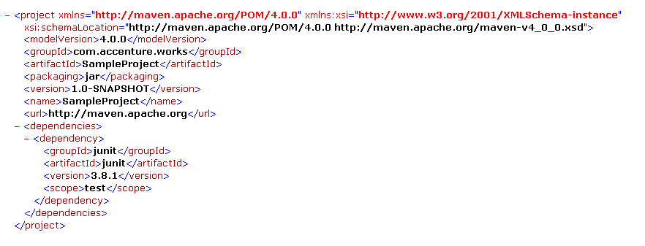
Sample pom.xml file
The file generated by the Archetype plug-in for SampleProject is shown below:
Notes:
Solutions Engineering Fundamentals: Java
Course #Z16325
© 2009 Accenture All Rights Reserved.
Faculty notes:
Maven Coordinates
The group ID: The entity or organization responsible for producing the artifact. For example, com.accenture.works can be a group ID. The artifact ID: The name of the actual artifact. For example, a project with a main class. The version: A version number of the artifact.
Note how the Archetype has defined the module's coordinates, defined the type as a JAR archive, and also specified JUnit as a dependency during the test phase (via the <scope> tag).

Slide 15
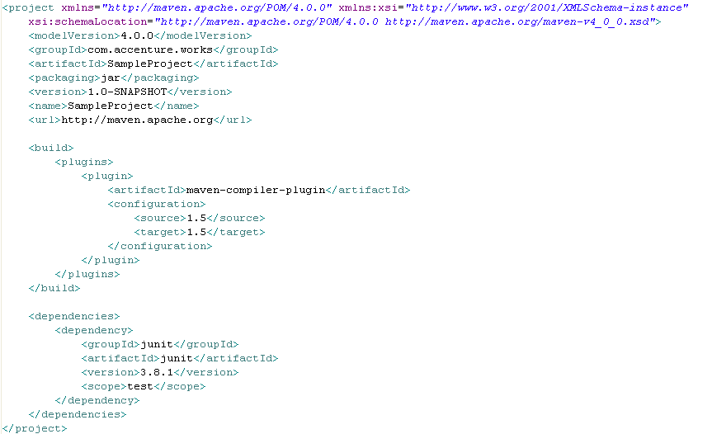

Customizing the generated pom.xml file

Slide 16
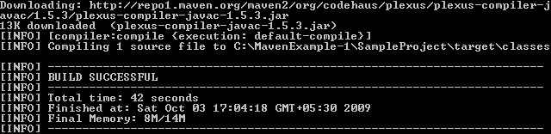
Compiling the customized Project
You can now compile the SampleProject using mvn compile command.
You should see the report of a successful build, creating one class file in the target tree.
This can take a little while if it is the first time you run it because some dependencies might need to be downloaded from the central repository over the Internet.
Notes:
Solutions Engineering Fundamentals: Java
Course #Z16325
© 2009 Accenture All Rights Reserved.

Slide 17
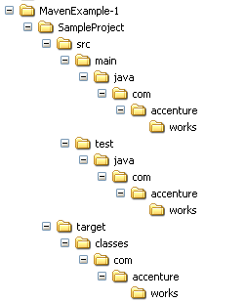
Directory structure after compilation
After compilation, the .class files (SimpleExample.class) file is created in the target folder shown below:
Notes:
Solutions Engineering Fundamentals: Java
Course #Z16325
© 2009 Accenture All Rights Reserved.
1

Slide 18
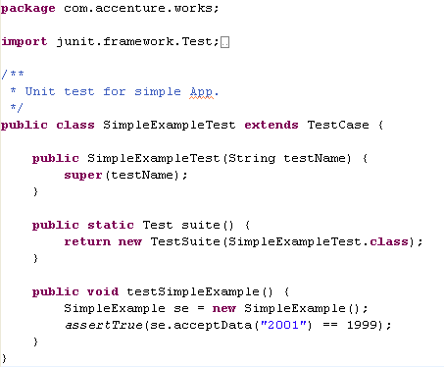
Adding a Unit test
It is a development best practice to provide unit tests for all code modules.
Maven 2 created a placeholder AppTest.java unit test for you. Remove the file and place the following SimpleExampleTest.java :
Notes:
Solutions Engineering Fundamentals: Java
Course #Z16325
© 2009 Accenture All Rights Reserved.
1

Slide 19
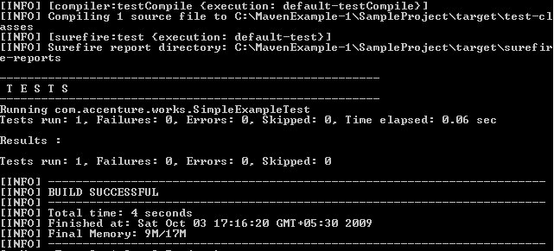
Running a unit test
You can use mvn test command.
Maven 3 compiles the source and the unit test. It then runs the tests, reporting on the number of successes, failures, and errors, as shown in the following figure:

Slide 20
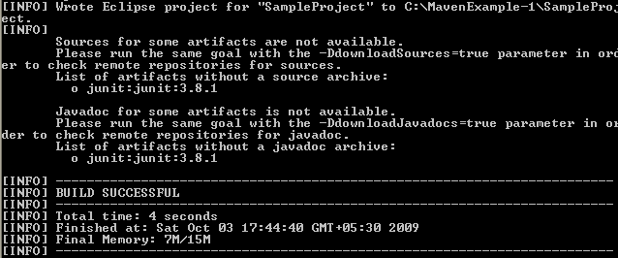
Creating eclipse specific files
It is easier for developers to work with Eclipse, hence Maven supports creation of eclipse specific files
To generate the eclipse metadata files from your pom.xml you execute the following command:
The above command generates eclipse related files like .project and .classpath .
Notes:
Participant Notes:
Eclipse IDE makes the java development easier for the developer. Thus, Maven supports creation of eclipse specific files. There is someone in the project(May be a application build engineer) who creates the Maven stuff and we developers can use it in Eclipse by importing.
Solutions Engineering Fundamentals: Java
Course #Z16325
© 2009 Accenture All Rights Reserved.
1

Slide 21
Importing the project in Eclipse
After generating the Eclipse Classpath and Project files for your project, import the project into Eclipse with the following steps:
From the Eclipse workspace menu select File > Import
2. Expand General and select Existing Projects into Workspace
3. Mark Select root directory and hit Browse. Browse for the directory in which your POM file is in. Press OK.
4. You should now see your project checked under the Projects: box. Press Finish.
5. You should now see your project in Eclipse.

Slide 22
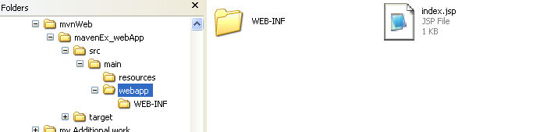
Creating a WAR file
Now let’s see how to create a simple Web application:
Execute the following command in the directory where you want the web application to be created.
The following directory structure will be created

Slide 23

Creating a WAR file (Continued…)
The directory structure created will be as per WAR file.
Maven provides us the required directory structure and template files.
We have to create web pages and place them in the proper locations.
For our application, lets use index.jsp file which is created by default.
Add your contents to index.jsp and save it.
Give following command in the command prompt.
Notes:
Solutions Engineering Fundamentals: Java
Course #Z16325
© 2009 Accenture All Rights Reserved.
Faculty notes:
-Explain to the participants that Maven just creates a web directory structure and template files like web.xml.
-We have to create the web pages and place them in the proper locations

Slide 24
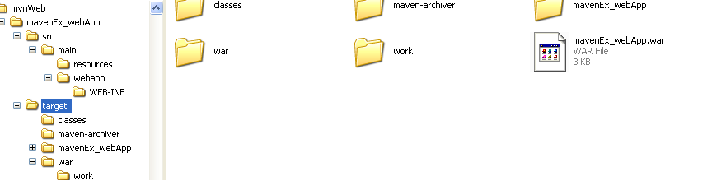
Creating a WAR file (Continued…)
Notice a war file created in the target folder
Deploy the same in a web server and request for index.jsp to see the output

